Slide 1
ROMANTIC IMAGINATION AND NATIONAL FEELING
1/10

Slide 2
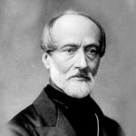
IDENTIFY THE PERSONALITY
An Italian Patriot
Soul of Italy
Beating heart of Italy
Poor man’s lawyer
?
2/10

Slide 3
Role of culture
Art.
Poetry.
Stories.
Music.
Emotions.
Intuitions.
Mystic feelings.
All these created a sense of :
shared collective heritage.
common cultural past.

Slide 4
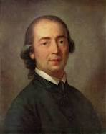
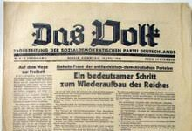
Johann Gottfried Herder
A German philosopher who
Claimed that true German culture was to be discovered among common people. He introduced:
1) Volksgeist
2)
4/10

Slide 5
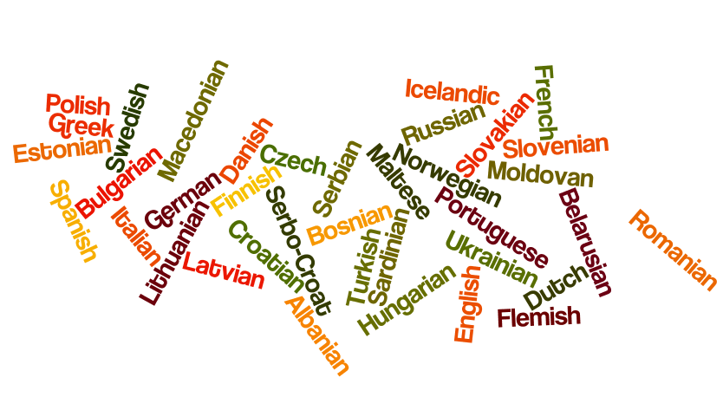
Vernacular languages
This was not just to recover an ancient national spirit
but also to carry the modern nationalist message to the large audiences who were mostly illiterate.
5/10

Slide 6
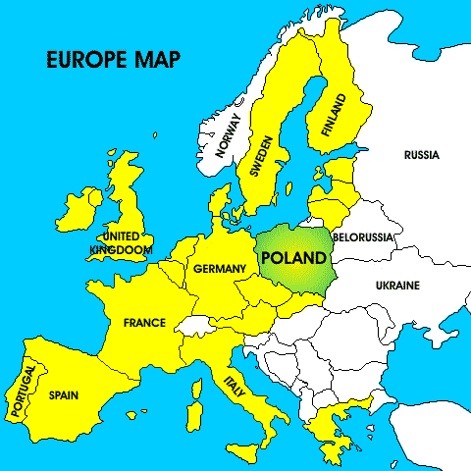
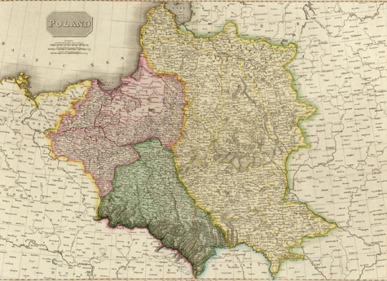
POLAND
6/10

Slide 7
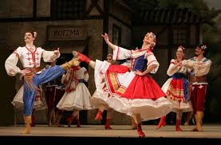
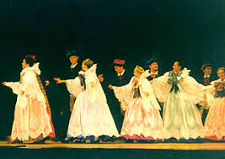
POLONAISE AND MAZURKA
7/10

Slide 8
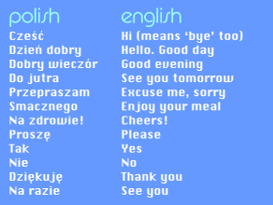
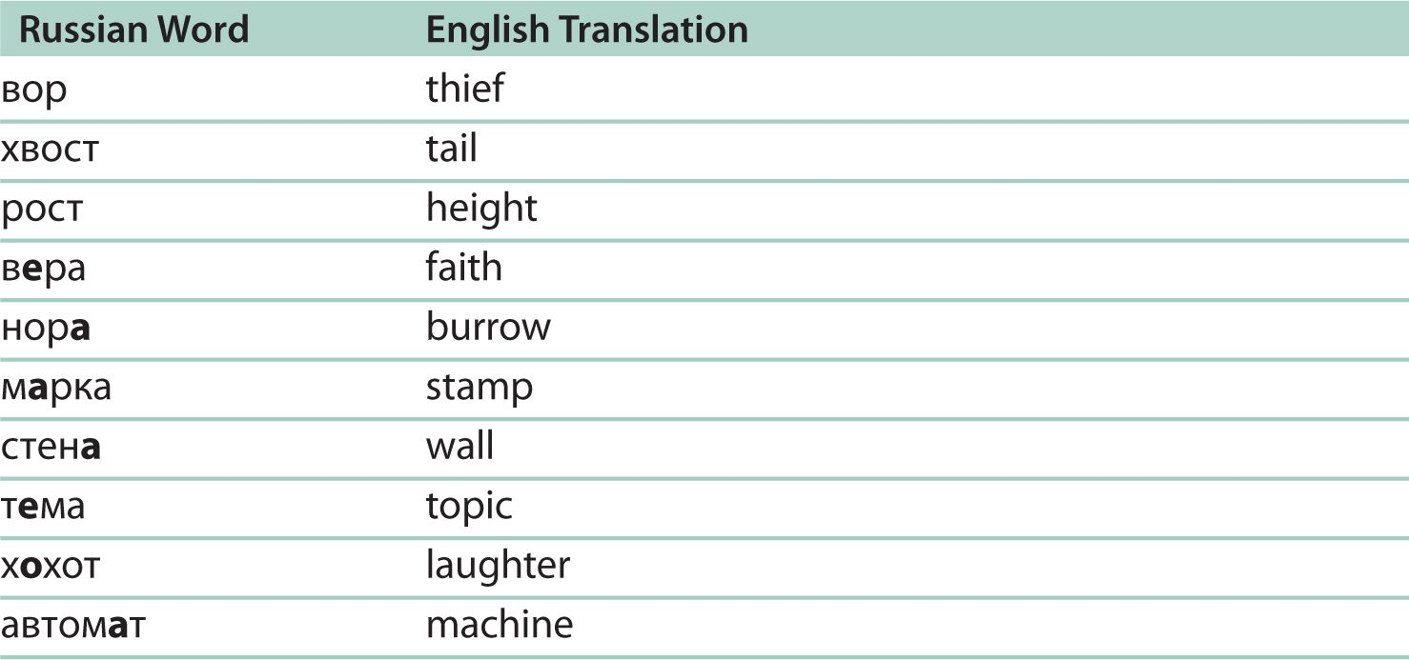
VERNACULAR LANGUAGES
POLISH
RUSSIAN
8/10

Slide 9
STATUS OF POLISH LANGUAGE
It was used only in church gatherings and Religious instruction.
.
As a result a large number of priests and bishops were put in the jail or sent to Siberia by the Russian authorities as a punishment for their refusal to preach in Russian.
9/10

Slide 10
To be continued……………..

